Slide 1
Agglomerative Hierarchical Clustering
- using Python.

Slide 2

Contents
Introduction and Business Objective
Agglomerative Clustering, and
its Process
Bottom-Up Approach & Benefits
Conclusion

Slide 3

Agglomerative clustering follows a bottom-up strategy, beginning by considering each data point as a separate cluster and gradually merging them based on their similarities until a single large cluster is formed encompassing all the objects. This method excels at detecting smaller clusters. This bottom-up approach is commonly observed in industries and companies that prioritize: 1. Innovation, 2. Flexibility, and 3. Swift adjustment to evolving market conditions.
Introduction & Business Aspect

Slide 4
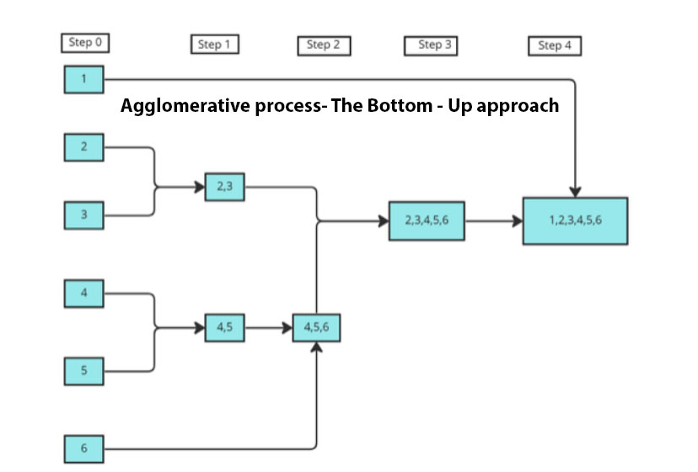
Flow Control

Slide 5
Procedure includes: The procedure for agglomerative clustering is as follows: 1. Calculate the proximity matrix by utilizing a distance metric. 2. Employ a linkage function to organize objects into a hierarchical cluster tree, taking into account the distance matrix obtained in the previous step. 3. Merge data points that have proximity to create a cluster.
Dendrogram:
The dendrogram serves as a graphical representation and classification tool for taxonomic relationships. It is commonly employed to depict the arrangement of clusters generated by hierarchical clustering.

Slide 6
Benefits
Detail-Oriented Start
Incremental Development
Empowerment and Participation
Local Insights and Adaptability:
Flexibility
Problem-Solving

Slide 7
Conclusion
Being a bottom-up approach, Agglomerative clustering is a tactic employed in diverse domains such as management, software development, and project planning. It involves commencing the process at the most intricate and fundamental level and gradually building up to create a comprehensive overview or solution.
GitHub Link: https://github.com/ds-stratgic-work/Implement-Agglomerative-Hierarchical-Clustering-using-Python.git

Slide 8


Thank You
dSights is a data tech specialist with a vision to create value through:
Outcome-Oriented AI
Fueled by
Innovative Experimentation

